Slide 1
KARNAUGH MAPS
Karnaugh Maps (K-Maps) with 2, 3, 4, and 5 variables
Neighborhood in K-Maps
Creating K-Maps of expressions in standard SoP form
Simplification of expressions in standard SoP form
Grouping cells and deriving simplified terms in K-Maps
Creating K-Maps of expressions in standard PoS form
Simplification of expressions in standard PoS form using K-Maps
Don’t Care Situations

Slide 2

Karnaugh Maps (K-Maps)
Karnaugh-Map, or K-Map in short, is a systematic approach to simplify logic expressions in SoP or PoS form.
K-Maps contain all the combinations of input values and the outputs just like truth tables. In truth tables, we place the binary values of inputs in rows, and we place the output values on the right column of the inputs.
In K-Maps, we place the binary values of inputs in row and column headers, and we place the output values in the cells just like a matrix. Then, we do the simplification by grouping these cells.
Maurice Karnaugh

Slide 3
Karnaugh Maps (K-Maps)
K-Maps are especially suitable for expressions with less variables. We use Quine-McCluskey method to simplify expressions with many variables.
The number of cells in a K-Map is equal to the number of combinations of input variables.

Slide 4
Karnaugh Maps with 2 and 3 Variables
A K-Map with 2 variables has 2² = 4 cells. Each cell denotes a minterm or a maxterm.
A K-Map with 3 variables has 2³ = 8 cells. Such a K-Map can be created in 2×4 or 4×2 matrix form.
We place the values of variables AB in 00–01–11–10 order. The reason for this is, we use Gray code numbers where sequential numbers differ only one bit from each other.
A B | 0 | 1
0 | A’B’ | A’B
1 | AB’ | AB
A B | 0 | 1
0 | m₀ | m₁
1 | m₂ | m₃
B A | 0 | 1
0 | m₀ | m₂
1 | m₁ | m₃
C AB | 0 | 1
00 | A’B’C’ | A’B’C
01 | A’BC’ | A’BC
11 | ABC’ | ABC
10 | AB’C’ | AB’C
AB C | 00 | 01 | 11 | 10
0 | A’B’C’ | A’BC’ | ABC’ | AB’C’
1 | A’B’C | A’BC | ABC | AB’C

Slide 5
Karnaugh Maps with 4 Variables
A K-Map with 4 variables has 2⁴ = 16 cells. Such a K-Map can be created in 4×4 matrix form.
CD AB | 00 | 01 | 11 | 10
00 | A’B’C’D’ | A’B’C’D | A’B’CD | A’B’CD’
01 | A’BC’D’ | A’BC’D | A’BCD | A’BCD’
11 | ABC’D’ | ABC’D | ABCD | ABCD’
10 | AB’C’D’ | AB’C’D | AB’CD | AB’CD’
AB CD | 00 | 01 | 11 | 10
00 | A’B’C’D’ | A’BC’D’ | ABC’D’ | AB’C’D’
01 | A’B’C’D | A’BC’D | ABC’D | AB’C’D
11 | A’B’CD | A’BCD | ABCD | AB’CD
10 | A’B’CD’ | A’BCD’ | ABCD’ | AB’CD’

Slide 6
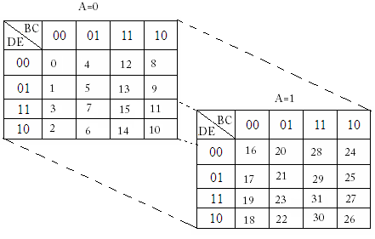
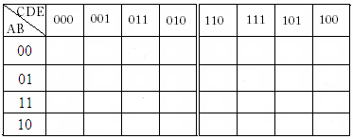
Karnaugh Maps with 5 Variables
A K-Map with 5 variables has 2⁵ = 32 cells. It can e considered as double 4-variable K-Maps. We handle the 5th variable separately.
For F(A,B,C,D,E);
Alternatively, we can create a 5-variable K-Map as depicted below.

Slide 7
Neighborhood in K-Maps
Cells correspond to input values. If input values of two cells differ only 1 bit, then these cells are considered to be neighbors. For example, in a 3-variable K-Map, a cell with input values 100 is a neighbor of the cells with input values 101, 000, and 110. If the difference is 2 bits (e.g. 010 and 001) these cells are not neighbors. Diagonal cells cannot be neighbors because there’s no way that they can differ only one bit.
Each cell has a neighbor on all sides. Pay attention that, the cell on the bottom and the cell on the top are neighbors in the K-Map given above.
The number of neighbors of a cell is equal to the number of variables.
C AB | 0 | 1
00 | X
01
11 | X
10 | X | X

Slide 8
Creating K-Maps of Expressions in Standard SoP Form
We put a 1 for each term in the logic expression in standard SoP form. We leave other cells empty. If there’s no 1’s on a K-Map, then the simplified logic expression is equal to 0. Likewise, if all the cells are 1, then the simplified logic expression is equal to 1. We can also create a K-Map from a truth table.
Example: Let’s create the K-Map of the logic expression given below
F(A,B,C) = A’B’C+AB’C+AB’C’
The binary input values that make the logic expression’s output 1 are;
A’B’C : 001
AB’C : 101
AB’C’ : 100
C AB | 0 | 1
00 |  | 1
01
11
10 | 1 | 1

Slide 9
Creating K-Maps of Expressions in Standard SoP Form
When we need to create the K-Map of an expression which is not in standard SoP form, then we need to convert it to Standard SoP form by expanding all the terms with missing variables. For example, if we have the term A’B in a 3-variable expression, then we need to expand this term with the missing variable C. The term A’B becomes A’B(C+C’) = A’BC+A’BC’. We learned how to do it in a practical way before.
Example: Let’s create the K-Map of the expression given below.
F(A,B,C)= AB’+A’B’C+B
The variable C is missing in term AB’.
So; AB’ = AB’C+AB’C’
The term A’B’C has all the variables.
The variables A and C are missing in term B.
So; B= A’BC’+A’BC+ABC’+ABC
F(A,B,C)= AB’C+AB’C’+A’B’C+A’BC’+A’BC+ABC’+ABC
C AB | 0 | 1
00 |  | 1
01 | 1 | 1
11 | 1 | 1
10 | 1 | 1

Slide 10
Simplification of Expressions in Standard SoP form
We do the simplification in 3 steps: Creating groups of 1’s, deriving terms from these groups, and generating the expression using these terms.
Grouping Rules
We group only neighbor cells.
Groups must contain as more cells as possible.
The number of cells in a group must be the power of 2. Groups can have 1, 2, 4, 8, 16, ... cells.
Groups must have a rectangular shape.
All the 1’s on the K-Map must belong to at least 1 group.
The main goal is to form least, and largest groups.

Slide 11
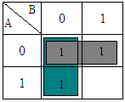
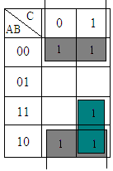
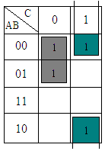
Grouping Cells and Deriving Simplified Terms in K-Maps
After creating groups, we derive a term from each group. If a group contains both 0 and 1 for a variable, we ignore that variable and use other variables to form the term.
B’+A’
B’+AC A’C’+B’C

Slide 12
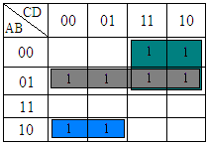
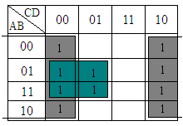
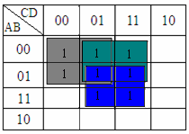
Grouping Cells and Deriving Simplified Terms in K-Maps
A’B+ A’C +AB’C’ D’+BC’
A’C’+A’D+BD

Slide 13
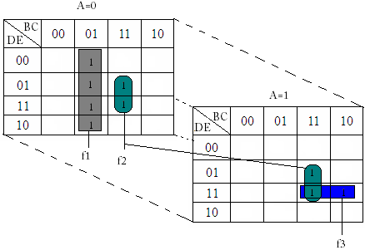
Grouping Cells and Deriving Simplified Terms in K-Maps
Example: Let’s simplify the expression given below using K-Map.
F(A,B,C,D,E) = ∑ (4,5,6,7,13,15,27,29,31)
We’ll handle the most significant variable (A) separately. First, we place the other variables on the headers of the maps. Then we place the minterms on the map. Overlapping cells are considered to be neighbors.
F=f1+f2+f3= A’B’C+ BCE+ ABDE
f1= A’B’C
f2= BCE
f3=ABDE

Slide 14
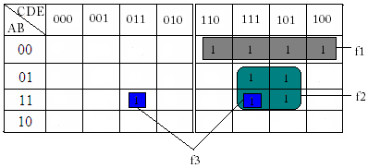
Grouping Cells and Deriving Simplified Terms in K-Maps
Example: Let’s simplify the expression given below using K-Map.
F(A,B,C,D,E) = ∑(4,5,6,7,13,15,27,29,31)
When grouping, we consider that we can bend the map vertically from the center. Overlapping cells are considered to be neighbors. In 6-variable K-Maps, we can bend the maps both vertically and horizontally. Likewise, overlapping cells are considered to be neighbors.
f1 = A’B’C
f2 = BCE
f3 =ABDE
F=f1+f2+f3

Slide 15
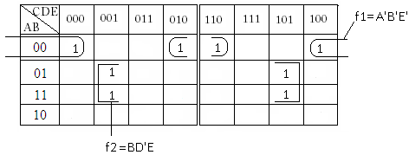
Grouping Cells and Deriving Simplified Terms in K-Maps
Example: Let’s simplify the expression given below using K-Map.
F(A,B,C,D,E) = ∑(0,2,4,6,9,13,25,29)
F=f1+f2=A’B’E’+BD’E

Slide 16
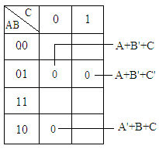
Creating K-Maps of Expressions in Standard PoS Form
In PoS form, we place 0’s to the cells that correspond to each term. We leave the other cells empty.
For example, in a 3-variable expression, we put 0 to the cell 101 that corresponds to the term (A’+B+C’).
Example: F(A,B,C)= (A’+B+C)(A+B’+C)(A+B’+C’)

Slide 17


Simplification of expressions in standard PoS form using K-Maps
Grouping procedure in PoS form is exactly the same as SoP form, except that we group 0’s instead of 1’s. After grouping, we derive sum terms from the groups, then form the expression by multiplying all the terms.
Example: If we place SoP terms on a map, the empty cells are actually the PoS terms. If we simplify the PoS expression below, we can see that it will be equal to the SoP expression we derive from the K-Map.
B.(A’+C’)
A’B+BC’

Slide 18
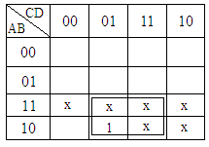
Don’t Care Situations
In some cases, variables may not be fully independent from each other. And in some other cases, it may not be possible for some combinations to occur. These situations are called “don’t care situations”.
For example, there are 6 don’t care situations in BCD code because 1010, 1011, … are invalid BCD codes. A don’t care situation is considered as 1 if it helps simplifying the expression. But if it doesn’t help simplifying the expression, then it is considered as 0.
Example: Consider a system that takes BCD code as input, and outputs 1 only when BCD input is 9 (1001). Let’s simplify this expression.
The simplified logic expression will be
f(A,B,C,D) = A.D

Slide 19
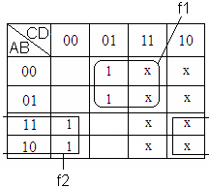
Don’t Care Situations
Example: F(A,B,C,D) = ∑(1,5,8,12)
Don’t care situations are F_{x}(A,B,C,D) = ∑(2,3,6,7,10,11,14,15)
Let’s simplify this expression.
f1 = A’.D
f2 = A.D’
F = f1+f2 = A’D+AD’= A⊕D

